Slide 1

Topological Magnonic Excitations in Correlated
Electron Systems
Jian-Xin Li
Department of Physics, and National Laboratory of Solid State Microstructure, Nanjing University, China
2019年凝聚态物理前沿研讨会， 青岛2019.7.26-28
Notes:
Ruthenium trichloride [ˈklɔ:raɪd]

Slide 2
Acknowledgments:
Zhao-Long Gu, Zhao-Yan Dong, Xiao-Fei Su
Shun-Li Yu

Slide 3
Outline
Introduction
Topological magnon (spin wave) in an One-dimensional
itinerant flat-band ferromagnet
Topological magnons in the Haldane-Hubbard model
with a nearly flat-band
Summary

Slide 4
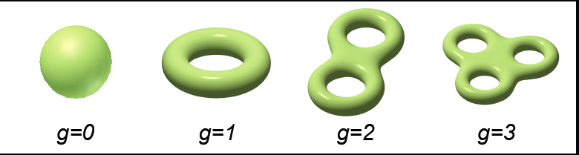
Topological quantum states
In Physics, computing topological invariants and using them to
classify the quantum states
Topological invariant： invariant under continuous transformation
Quantum Hall state provided the first example of a quantum state
topologically distinct from all states of matter known before

Slide 5
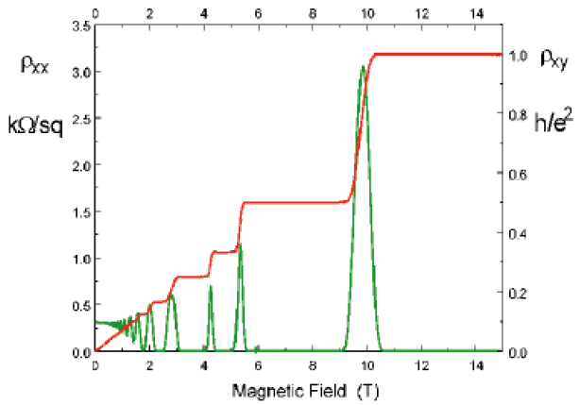
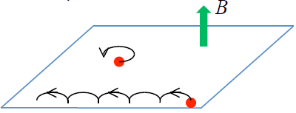
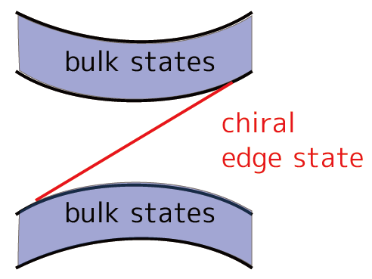
Quantum Hall effect
Exp.: Quantization of Hall conductance
Chern number
F: Berry’s curvature
TKNN invariant
Thouless-Kohmoto-Nightingale-den Nijs (1982)
Physical quantity is related to topological invariant
Time reversal symmetry
is broken
Notes:
5

Slide 6
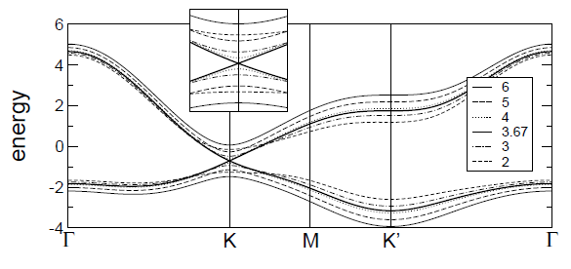
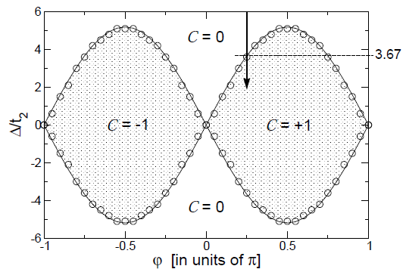
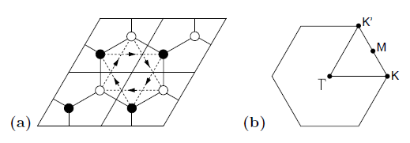
Haldane model and Chern insulator
F.D.M. Haldane, PRL61, 2015 (1988)
Macroscopic magnetic flux through a unit cell is zero
➔no macroscopic magnetic field
Time-reversal symmetry is broken
Chern insulator (Quantum anomalous Hall effect): nonzero band Chern number
Topological phase transition: gap closing and reopening

Slide 7
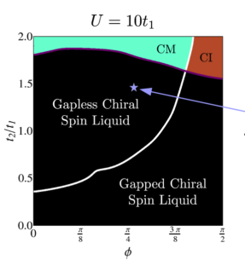
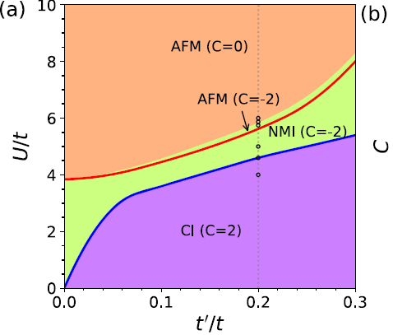
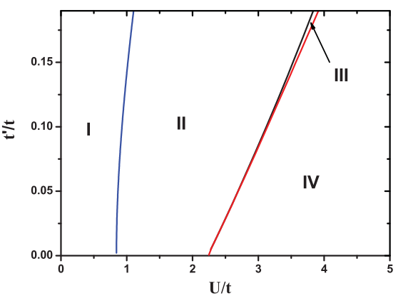

Haldane-Hubbard model
Phase diagram
PRB 88, 241101 (2013); PRB 93, 075131 (2016); PRL 116, 225305 (2016)…
Slave rotor phase diagram with$φ=\frac{π}{2}$
J. He, S. –P. Kou, Y. Liang and S. Feng,
PRB 83, 205116 (2011); ibid., 84, 035127 (2011)
C. Hickey, etal., PRB 91, 134414 (2015)
C. Hickey, etal., arXiv: 1509. 08461v1
Z.L.Gu, K.Li and J.X.Li,
New J.Phys.21, 073016 (2019)

Slide 8
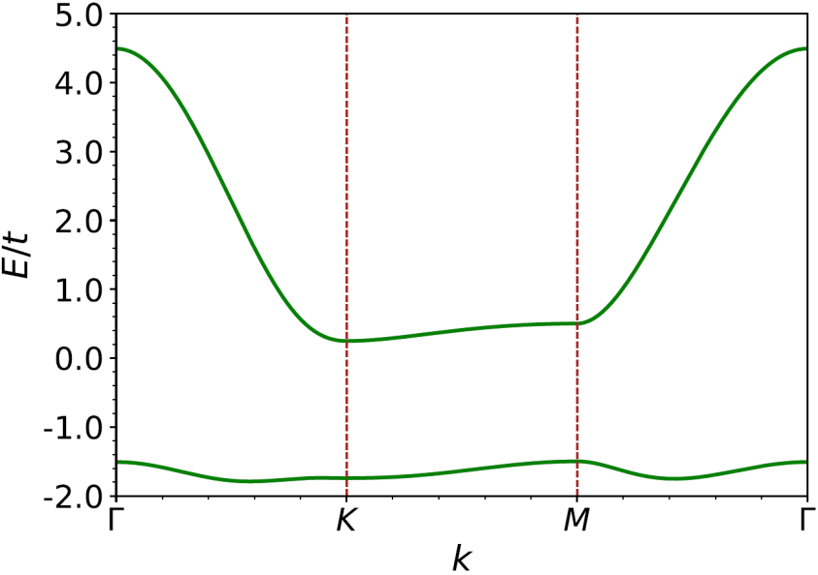
Haldane-Hubbard model with a nearly flat band
Electron energy band for the Haldane model
High temperature quantum anomalous Hall effect when a Hubbard U is added
Hubbard interactions induce ferromagnetism on the nearly flatband and polarize the spins
At quarter filling, one of the spin-polarized band (ground state) is fully occupied, giving rise to QAHE
T. Neupert, et al, PRL 106, 236804 (2011); T. Neupert, et al., PRL. 108, 046806 (2012)
R. L. Doretto, and M. O. Goerbig, PRB 92, 245124 (2015)
Y. F. Wang, Z. C. Gu, C. D. Gong, and D. N. Sheng, PRL 107, 146803 (2011)

Slide 9
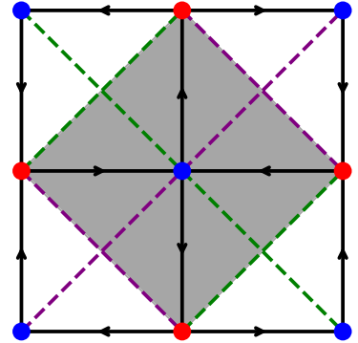
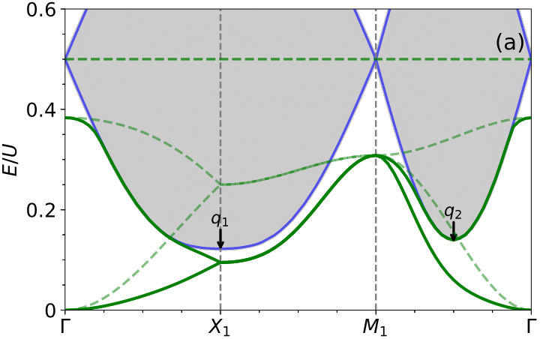
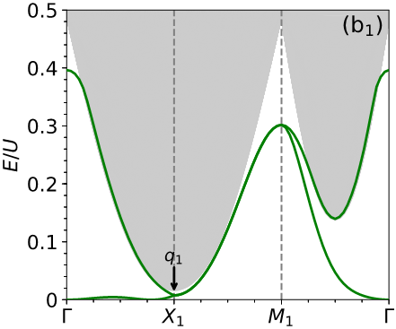
Ferromagnetism is the necessary condition for QAHE, but has not be explored before
Spin excitation spectra of Chern Hubbard model
X. F. Su, Z. L Gu, Z. Y. Dong, S.L.Yu and J. X. Li, PRB 99.014407 (2019)
In the FM phase
At the critical line
Instability of the ferromagnetism: softening of the roton-like mode

Slide 10
Flat electron band (Metallic state) → Itinerant ferromagnetism (adding U)
A gap between spin up and down bands → QAHE (topological state)
Excitations from FM ground state→Spin waves (topological trivial)
Magnon energy band

Slide 11
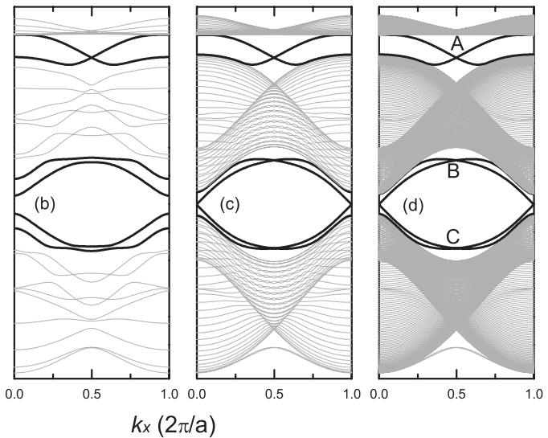
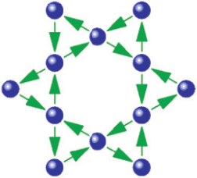
Topological magnons in spin systems
Y. Onose, T. Ideue, H. Katsura, Y. Shiomi, N. Nagaosa, and Y. Tokura, Science 329, 297 (2010)
L. Zhang, J. Ren, J.-S. Wang, and B. Li, Phys. Rev. B 87, 144101 (2013)
In a ferromagnetism with local spins
The DM interaction plays the role of the vector potential for magnons.
Holstein-Primakoff transformation to
bosonic operators：
Flux induced by DM term

Slide 12
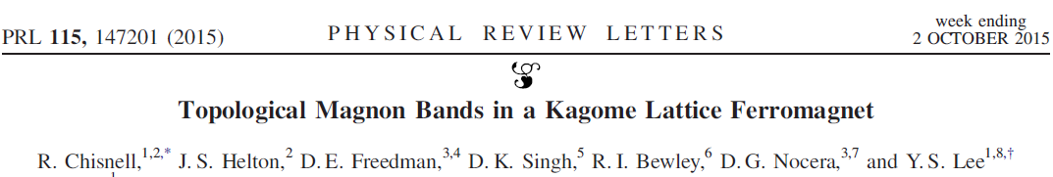
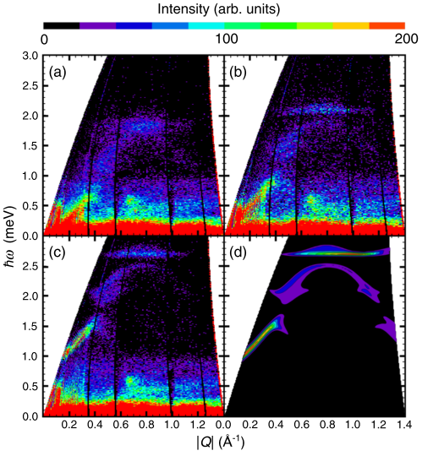
Consequence--Inelastic Neutron Scattering of Cu(1,3-bdc)
(d) Theoretical result based
on the nearest-neighbor
ferromagnet with DM interaction

Slide 13
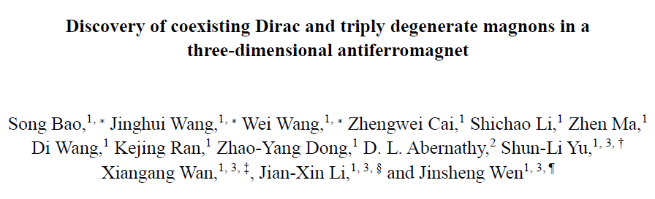
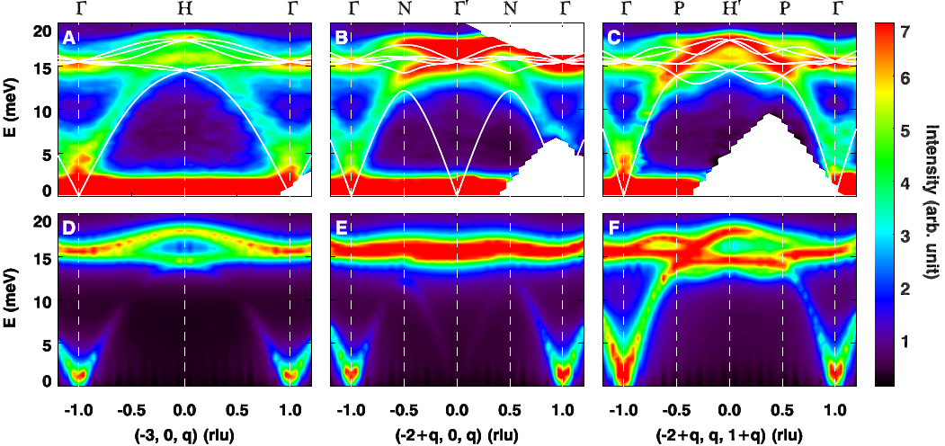
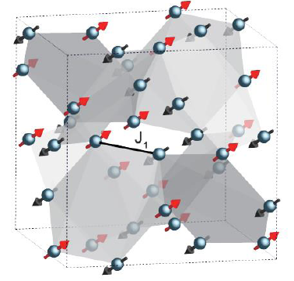
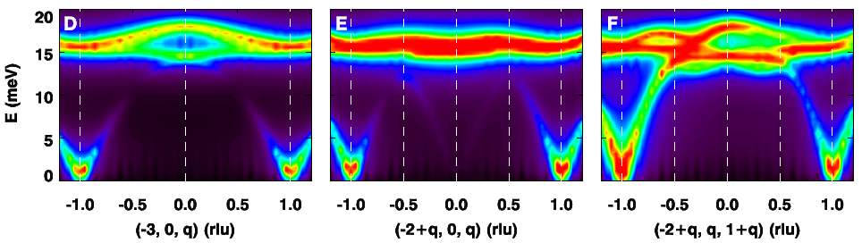
Nat Commun. 9, 2591 (2018)
First example where Dirac and triply degenerate magnonic nodal excitations exist

Slide 14
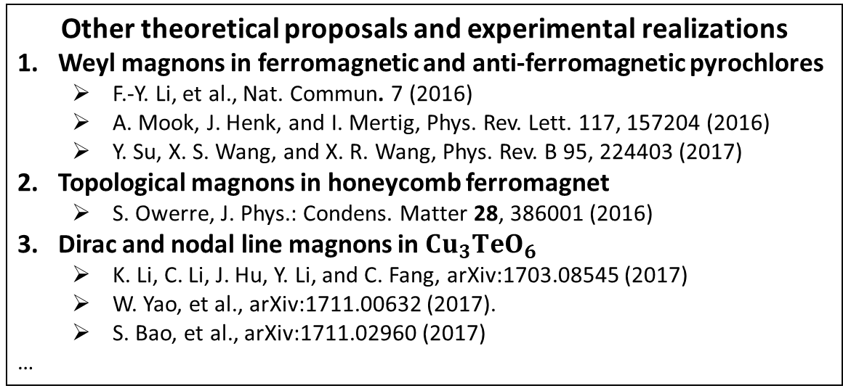
Other theoretical proposals and experimental realizations
Weyl magnons in ferromagnetic and anti-ferromagnetic pyrochlores
F.-Y. Li, et al., Nat. Commun. 7(2016)
A. Mook, J. Henk, and I. Mertig, Phys. Rev. Lett. 117, 157204 (2016)
Y. Su, X. S. Wang, and X. R. Wang, Phys. Rev. B 95, 224403 (2017)
Topological magnons in honeycomb ferromagnet
S. Owerre, J. Phys.: Condens. Matter 28, 386001 (2016)
Dirac and nodal line magnons in $Cu_{3}TeO_{6}$
K. Li, C. Li, J. Hu, Y. Li, and C. Fang, arXiv:1703.08545 (2017)
W. Yao, et al., arXiv:1711.00632 (2017).
S. Bao, et al., arXiv:1711.02960 (2017)
…
Can topological magnons emerge in itinerant magnets?
Local spin model
Linear SWT

Slide 15
Topological Magnons in an One-dimensional
Itinerant Flat-Band Ferromagnet
X.F. Su, Z.L.Gu, Z.Y. Dong and J.X. Li, PRB 97, 245111 (2018)

Slide 16
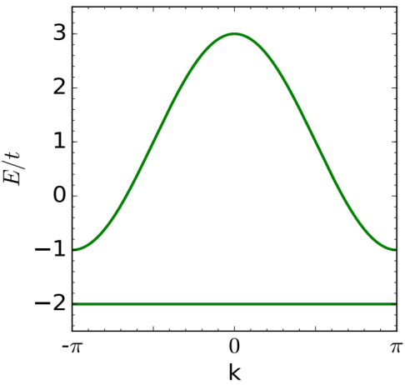
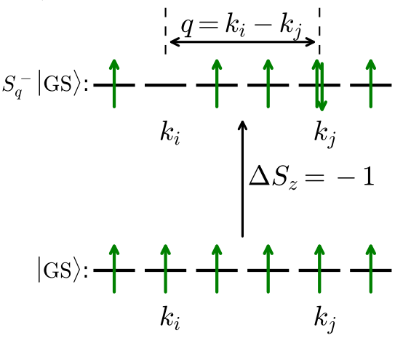
Projected exact diagonalization (PED) method
When there is an appreciable gap between the upper and flat bands, one can project H into the flat band
The ground state of a half-filled flat electron band with Hubbard interactions is an itinerant ferromagnet
Creation of a spin-1 excitation with a center-of-mass momentum q
q is a good quantum number
For a fixed q, is a invariant subspace
This projection simplifies hugely the solution, because the Hilbert space is linear with respect to the system size –PED
We can carry out the investigations with a lattice sites up 1600 in a 1D system

Slide 17
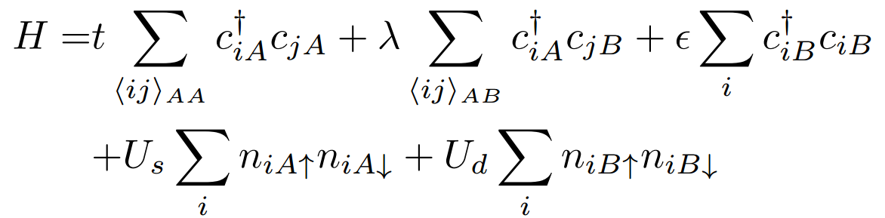
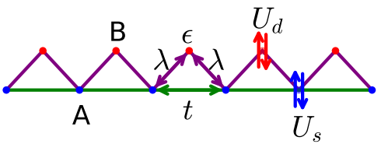
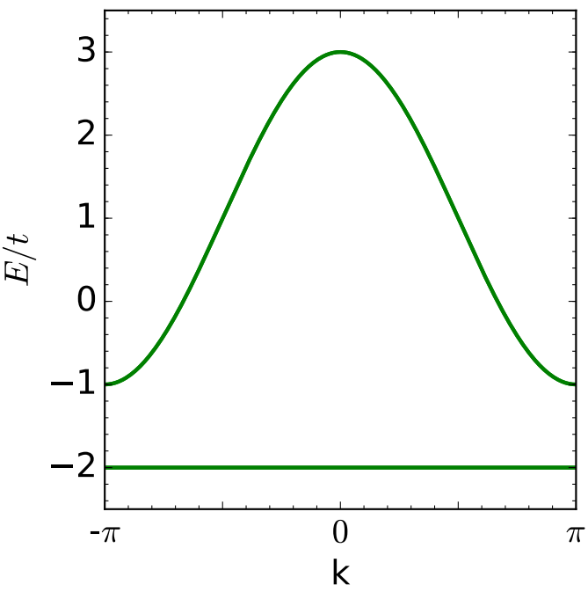
Topological magnons in 1D itinerant flat-band ferromagnets
X.F. Su, Z.L.Gu, Z.Y. Dong and J.X. Li, PRB 97, 245111 (2018)
A 1D quarter filled periodic Anderson model with impurities locating at the center of the bonds and hybridizing with their neighboring sites, together with a Hubbard repulsion for the conducting electrons
The free electron band

Slide 18
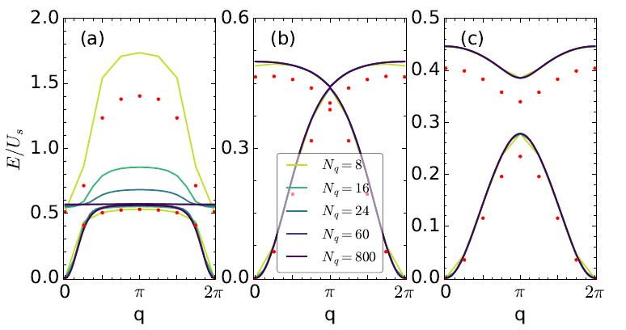
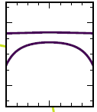
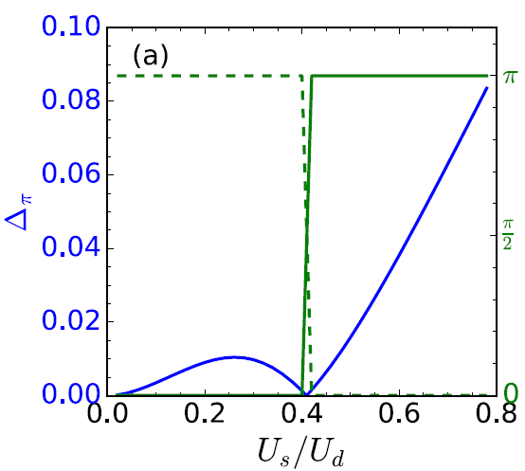
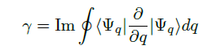
Magnon band for three different Us=0.02t, 0.4t and 0.78t
Us=0.02
Us=0.4
Us=0.78
Red dots represent the exact diagonalization of a system with Nq= 8

Slide 19
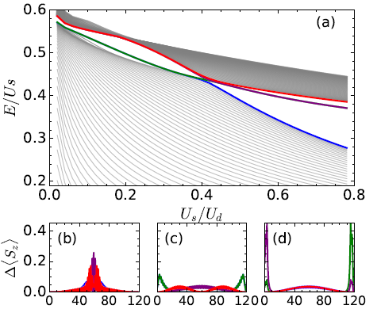
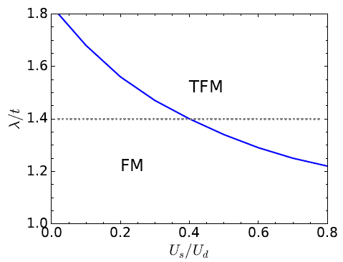
Magnon spectrum with open
boundary condition
and Us play a cooperative role in the
generation of topological magnons
Phase diagram
Topological magnon
magnon

Slide 20
Topological Magnons in the Haldane-Hubbard Model
with a Nearly Flat-Band
Z.L.Gu, Z.Y. Dong, S.L.Yu and J.X.Li, to be published
Projected exact diagonalization (PED) method

Slide 21
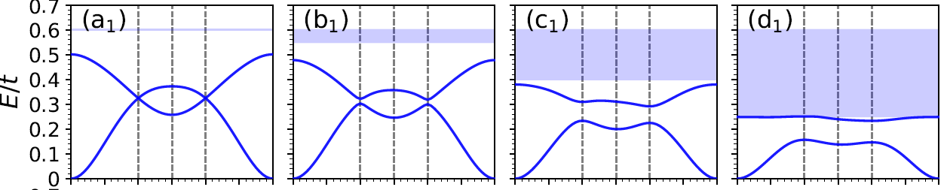
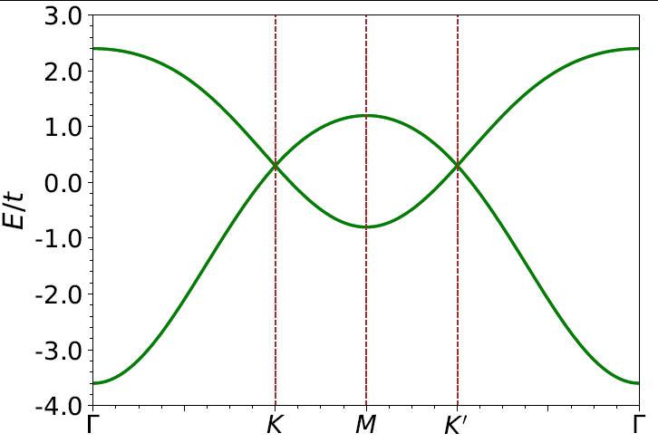
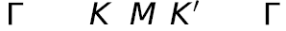
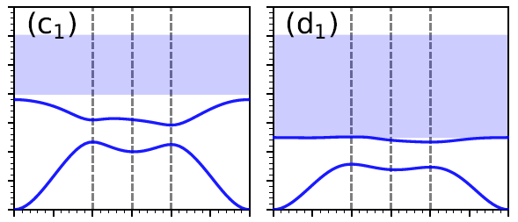
Spin-1 excitation spectra from the itinerant ferromagnetic
ground state in the Haldane-Hubbard in the flat-band limit
Tight-binding energy band
for electrons
Dirac magnon
Dirac magnon open a trivial gap when

Slide 22
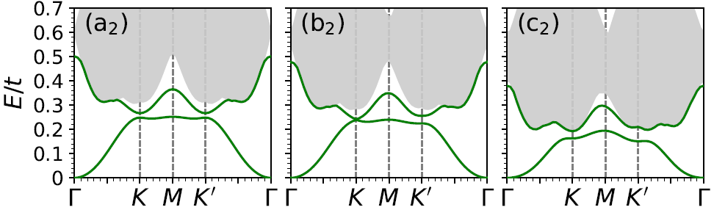
Spin-1 excitation spectra for a nearly flat-band with dispersion
It opens a topological gap
C=+1
A topological phase transition occurs associated with the gap closing and reopening
C=0

Slide 23
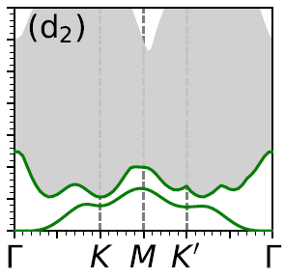
Spin-1 excitation spectra for a nearly flat-band with dispersion
The imbalance will eventually destabilizate the ferromagnetic ground state via the softening of a roton-like mode

Slide 24
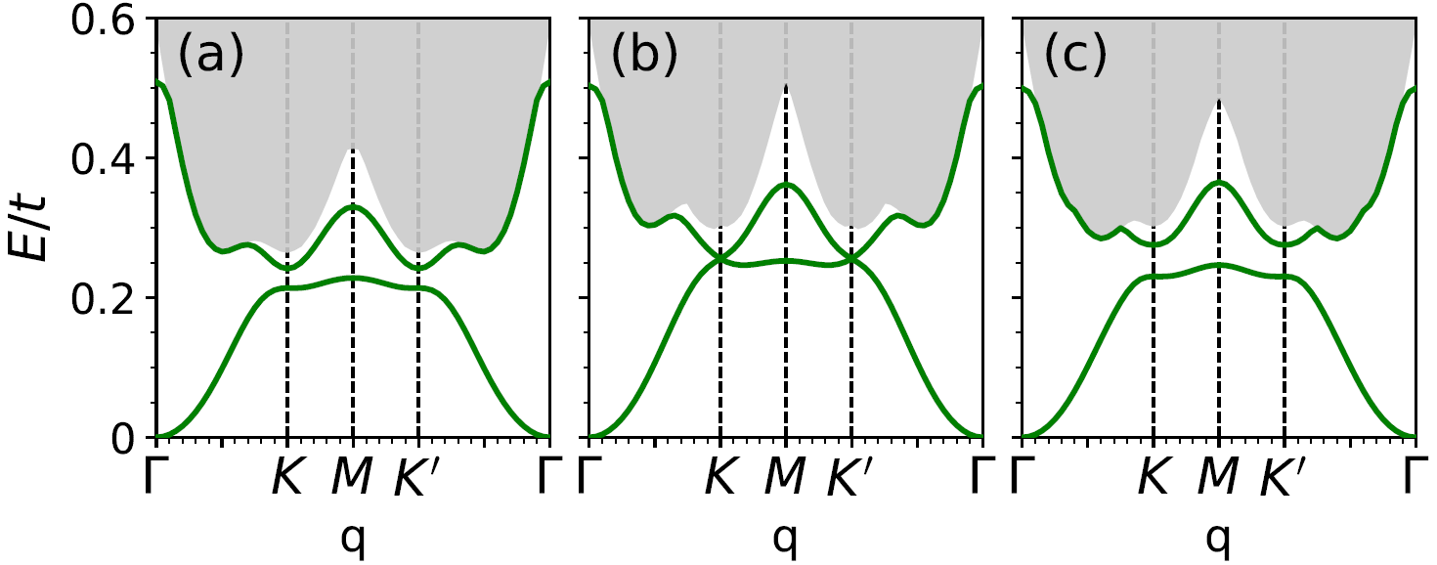
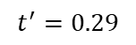
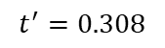
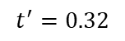
Spin-1 excitation spectra for a nearly flat-band with dispersion
--Effect of the nearest-neighbor hopping t’
$$t^{′}=0.29$$
$$t^{′}=0.308$$
$$t^{′}=0.32$$
C=+1
C=-1
Other parameters: $t=1.0, φ=0.656, U_{A}=U_{B}=1.2$
Associating with the gap closing and reopening , a topological phase transition
occurs between two topological phases with opposite Chern numbers

Slide 25
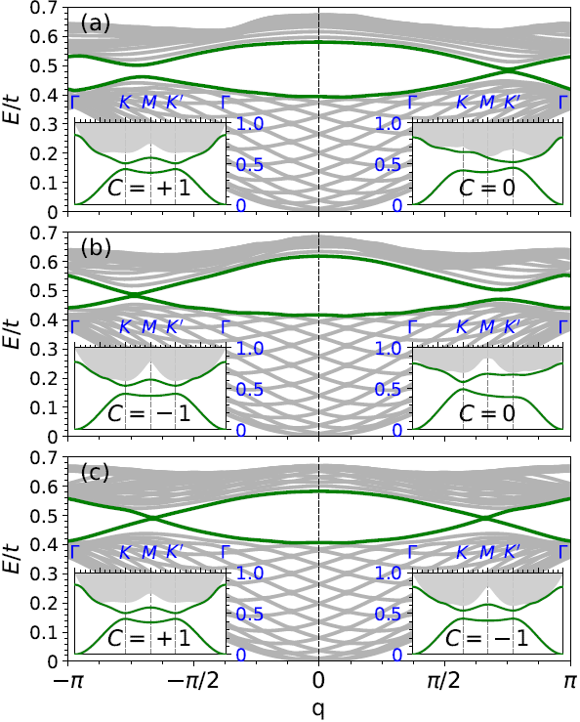
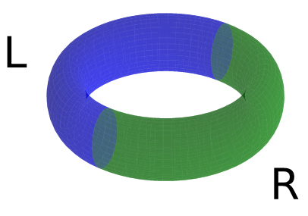
Bulk-edge correspondence
Domain wall geometry
The existence of itinerant topological magnon:
Nonzero Chern number
Chiral magnonic edge modes
Topological transition characterized by the gap closing and reopening

Slide 26
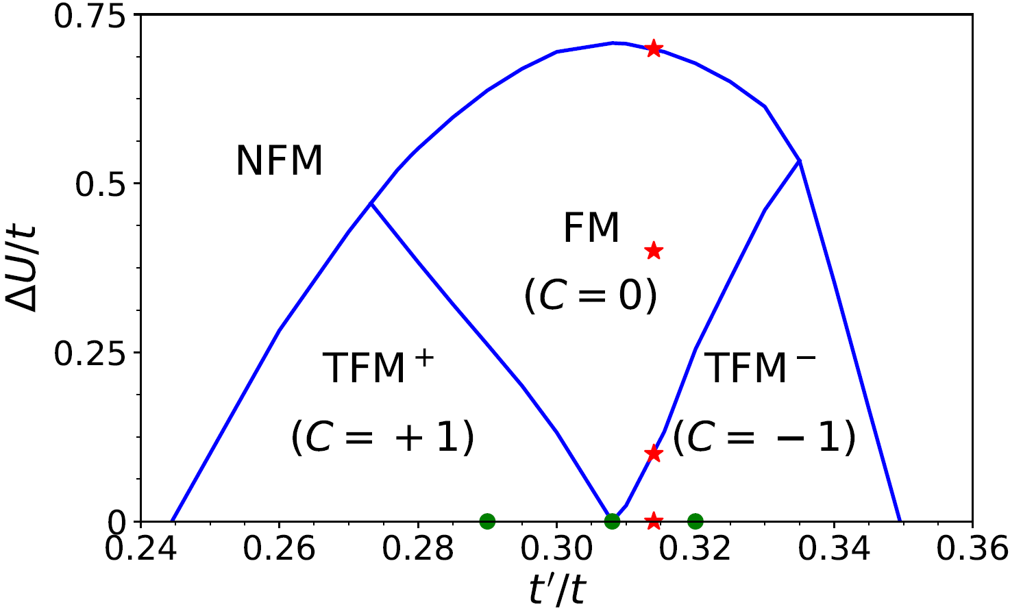
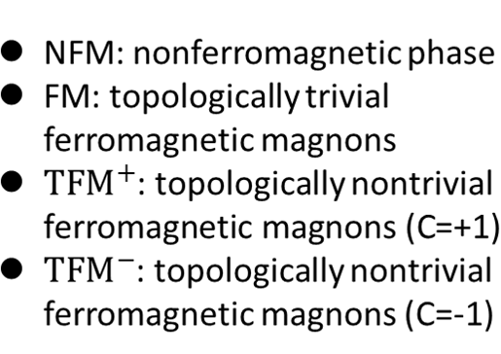
Summary of the numerical results

Slide 27
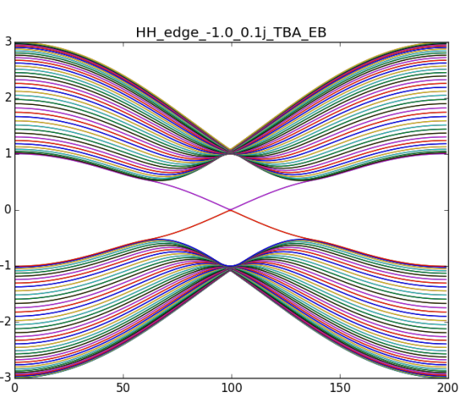
An understanding of the origin of the topological state
Haldane model:
Pictorially, the phase induces an effective magnetic field and leads to integer QHE
Inverse Mass Mechanism
Mass term:
+1
-1
Criteria
Topological phase
Trivial phase
Topological state arises from the inverse of the mass

Slide 28
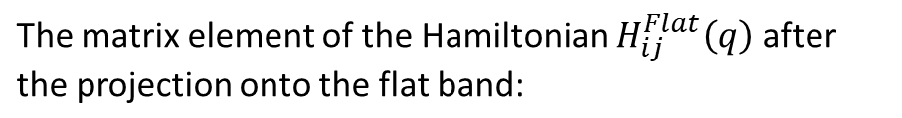




Effective bases of the spin waves in the flat-band Haldane-Hubbard model
Define the “flatband particle-hole vector” of a sublattice as:
The whole Hamiltonian can be written as a direct product of which can be taken as the bases of the spin waves. Then, the Hamiltonian is represented by a 2×2 matrix. When UA= UB and in the flatband limit,

Slide 29




An understanding of the origin of the topological state
When considering the dispersion of electron band and the imbalance , the
first and second terms in the Hamiltonian can be taken as a perturbation
is the mass term of the Dirac magnon
Spin waves by the effective model
(a) $U_{B}=1.2$, (b) $U_{B}=1.04$, (c) $U_{B}=0.8$
Other parameters: $t=1.0, t^{′}=0.314, φ=0.656, U_{A}=1.2$

Slide 30
Summary
We propose a new scenario that topological magnons can
emerge from itinerant flat-band ferromagnet, which is
different from previous ones that topological magnons exists
in local spin models.
The topological magnon is shown to exist in the correlated
1D periodic Anderson model with impurities in between,
and 2D Haldane-Hubbard model with a nearly flat-band.
We find an effective bases for the spin waves and elaborate
that the inverse mass mechanism leads to the emergency of
the itinerant topological magnons.

Slide 31
Thank you for your attention

Slide 32

Effects of the nonflatness of the lower band
The band becomes dispersive when deviating from the condition
drives the system to be topological nontrival as the Hubbard interaction does
Interaction driven topological transition

Slide 33

Flat electron band (Metallic state) → Itinerant ferromagnetism (adding U)
A gap between spin up and down bands → QAHE (topological state)
Excitations from FM ground state→Spin waves (topological trivial)
Magnon energy band
electronic energy band

Slide 34


In most cases, the systems with local spins will have a magnetically ordered ground state
Ferromagnetism
Antiferromagnetism
J<0
J>0
One of the simplest local spin model -- Heisenberg Model
Expressing spin operators in terms of bosonic operators—HP transformation

Slide 35

In the linear spin-wave approximation
Low-energy excitations in a magnetic ordered systems
--spin-waves (magnon)
Spin waves are propagating fluctuations about the ordering of a
magnetic ground state, which behave just a system of independent
harmonic oscillators

